Slide 1
Discussion 3
Post-MT1, Recursion, Tree Recursion
Jason Zhou | Section 136
CS61A Spring 2019

Slide 2
Announcements
Thursday 2/21: HW3 Due
Friday 2/22: (Optional) Hog Contest

Slide 3
Feedback
links.cs61a.org/jasonz-feedback

Slide 4
Agenda
Post-MT1 Thoughts
Recursion/Tree Recursion
Practice

Slide 5
Post-MT1 Thoughts

Slide 6
Post-MT1 Thoughts
Firstly:
Great Work!
First line of code in CS61A → Hog & MT1 in ~2 weeks
A ton of progress in very little time.
61A: highly rigorous & challenging
Bigger picture behind the assignments...

Slide 7
Post-MT1 Thoughts
Recovery Points
Scores below 50% raw on MT1
Labs, Lab-Checkoffs, Discussion Attendance
Your relative performance matters the most
Percentile is better indicator than raw score
MT1: 30 pts/300 pts
(MT2: 60 pts) + (Final: 75 pts) = 135 pts/300 pts
Lots of room for progress & improvement

Slide 8
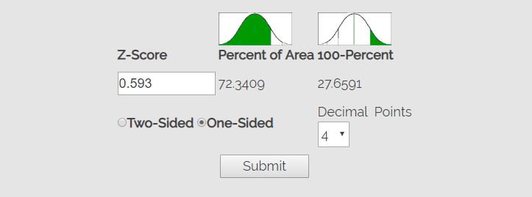
Post-MT1 Thoughts
Statistics
Mean: 18.98 (~63%) | Median: 20.5 | Standard Deviation: 7.6
Z_score = (Your_score - Median) / Standard Deviation
Example: 22/30 / Z_score = (22 - 20.5) / 7.6 = 0.197
https://measuringu.com/pcalcz/

Slide 9
Post-MT1 Thoughts
How we grade:
~3 hrs creating, testing, tuning rubrics
Rubrics won’t change for regrades for 1 person
If there is a change, will apply to the entire class
~5-6+ hrs grading session
Each TA grades ~200-500 students for 1 question
Mistakes happen!
Check your exam against rubric & solutions
+1 point can make a difference for your grade

Slide 10
Post-MT1 Thoughts
MT2: March 20th …
Significantly longer than MT1
Worth more than midterm 2’s of past semesters
Format of problems similar to MT1
WWPD
Environment Diagram
(Short Answer/Multiple Choice)
Coding Questions
Recursion
Tree Recursion

Slide 11
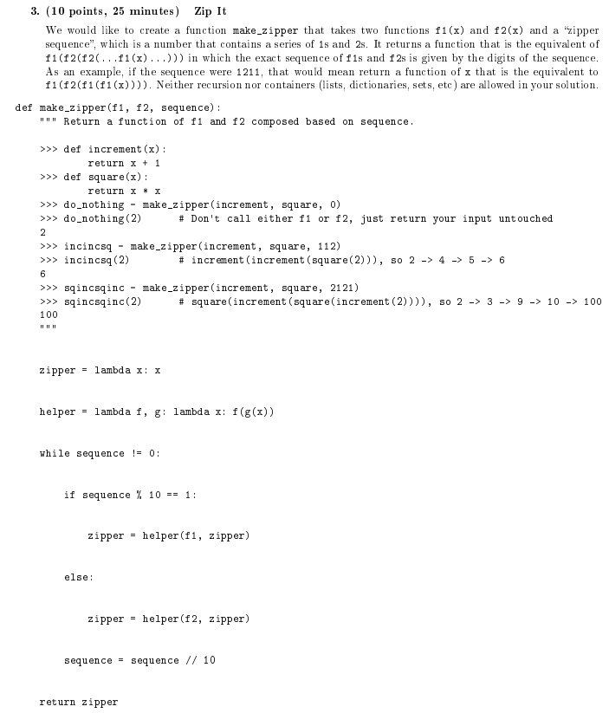

Slide 12
Recursion
Intuition
Definition
Tackling Recursion

Slide 13
Recursion: Intuition
Problem:
Want to find the digit sum of a number x.
Assume x has n digits total.

Slide 14
Recursion: Intuition
Solution 1:
Somehow, get the last digit of x, add it to my answer.
Somehow, remove the last digit from x.
Repeat steps 1 and 2 until all digits in x are gone.
Get last digit: x % 10
Remove last digit: x = x // 10
Code:
def digitSum(x):
answer = 0
while x > 0:
answer = answer + x%10
x = x//10
return answer

Slide 15
Recursion: Intuition
Solution 2:
Somehow, get the sum of the first (n-1) digits of x.
Somehow, get the last digit of x.
Add the result from step 1 and step 2.
Get the sum of the first (n-1) digits of x: f(x)
Get the last digit: x % 10
Code:
def digitSum(x):
return f(x) + x % 10
digitSum(x) returns digit sum of x.
f(x) returns digit sum of first (n-1) digits of x.
f(x) = digitSum(x//10)

Slide 16
Recursion: Intuition
Code:
def digitSum(x):
return digitSum(x//10) + x % 10
digitSum(121)
=> digitSum(12) + 1
=> digitSum(1) + 2 + 1
=> digitSum(0) + 1 + 2 + 1
def digitSum(x):
if x == 0:
return 0
return digitSum(x//10) + x % 10

Slide 17
Recursion: Intuition
Solution 1:
def digitSum(x):
answer = 0
while x > 0:
answer = answer + x%10
x = x//10
return answer
Solution 2:
def digitSum(x):
if x == 0:
return 0
return digitSum(x//10) + x % 10
Iterative Recursive

Slide 18
Recursion
Solving an instance of a problem...
...using smaller instances of the same problem
def digitSum(x):
if x == 0:
return 0
return digitSum(x//10) + x % 10
Anatomy:
Recursive Call: Calling smaller instances of the same problem
Base Case: Smallest instance of this problem, requires no recursive call
Base Case
Recursive Step

Slide 19
Tackling Recursion
Recursive Leap of Faith
Assume the recursive function, f(x), works correctly for inputs smaller than x.
Base Case
def digitSum(x):
if x == 0:
return 0
return digitSum(x//10) + x % 10

Slide 20
Practice

Slide 21
Tree Recursion: Intuition
Problem:
How many possible ways to walk down n steps?
Can only take 1 or 2 steps at a time.
Example with 5 steps:
Possible sequence: 1, 1, 1, 1, 1
Possible sequence: 1, 1, 2, 1
Possible sequence: 1, 2, 1, 1
Etc…
def stairs(n):

Slide 22
Tree Recursion: Intuition
Starting at the top of the n steps.
Can take 1 or 2 steps right now.
Choice 1: take 1 step right now.
n-1 steps left.
How many ways to get down n-1 steps?
stairs(n-1) ways.
If I take 1 step right now, I have stairs(n-1) ways to get to the bottom.

Slide 23
Tree Recursion: Intuition
Choice 2: take 2 steps right now.
n-2 steps left.
How many ways to get down n-2 steps?
stairs(n-2) ways.
If I take 2 step right now, I have stairs(n-2) ways to get to the bottom.

Slide 24
Tree Recursion: Intuition
If I take 1 step right now, I have stairs(n-1) ways to get to the bottom.
If I take 2 step right now, I have stairs(n-2) ways to get to the bottom.
I can only take 1 or 2 steps right now.
Total number of ways to get to the bottom:
ways to the bottom if I take 1 step right now +
ways to the bottom if I take 2 steps right now
stairs(n-1) + stairs(n-2) ways.

Slide 25
Tree Recursion: Intuition
def stairs(n):
return stairs(n-1) + stairs(n-2)
2 Base Case(s):
if n == 1: return 1
Possible sequence: 1
if n == 2: return 2
Possible sequence: 1, 1
Possible sequence: 2

Slide 26
Tree Recursion: Intuition
def stairs(n):
if n==1:
return 1
if n==2:
return 2
return stairs(n-1) + stairs(n-2)
Done.

Slide 27
Tree Recursion: Intuition
stairs(5)
stairs(4) + stairs(3)
stairs(3) + stairs(2) + stairs(2) + stairs(1)
stairs(2) + stairs(1) + 2 + 2 + 1
2 + 1 + 2 + 2 + 1
8 ways.

Slide 28
Tree Recursion
!= Trees
Recursion:
Solving an instance of a problem...
...using smaller instances of the same problem
Tree Recursion:
Solving an instance of a problem...
...using more than 1 smaller instances of the same problem
Often used for enumeration
i.e. Exploring all possible ways to do something

Slide 29
Tree Recursion Structure
stairs(5)
stairs(4) + stairs(3)
stairs(3) + stairs(2) + stairs(2) + stairs(1)
stairs(2) + stairs(1) + 2 + 2 + 1
2 + 1 + 2 + 2 + 1

Slide 30
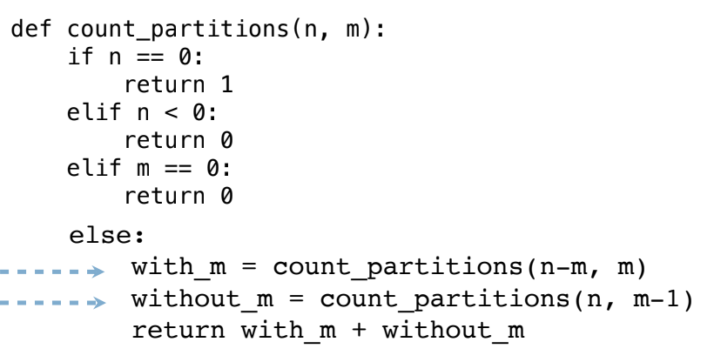
Count Partitions

Slide 31
Practice

Slide 32
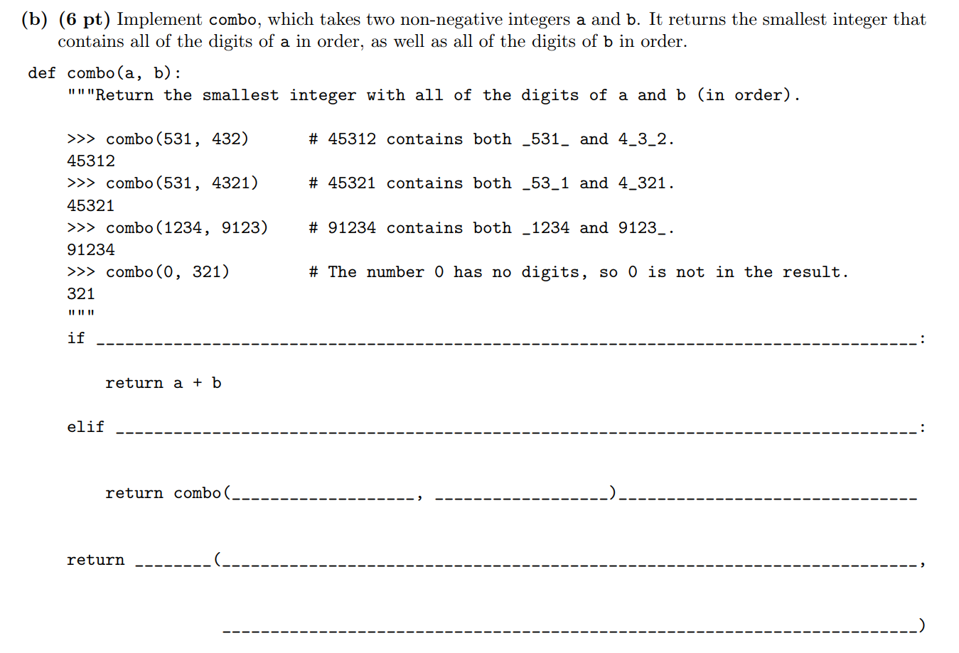
Sp. 18 Q4

Slide 33
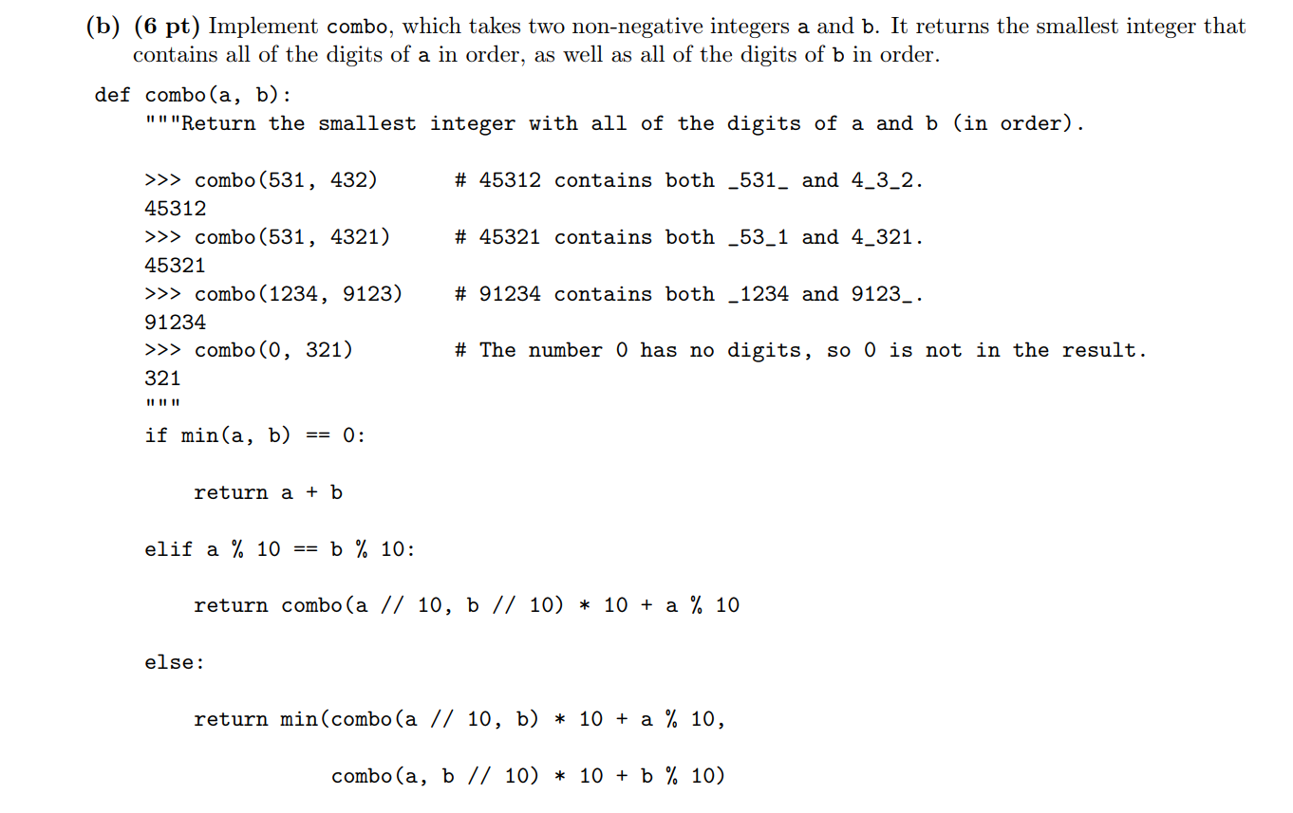

Slide 34
Attendance
links.cs61a.org/jasonz-attendance

